Slide 1

An automated system to limit COVID-19 using
Facial Mask Detection in a smart city Network
Date : 22 April 2021
Kanumuri SumaVallika - 17wh1a0542
Praneetha Bhupathiraju - 17wh1a0551
Bathula Varshitha Veena -17wh1a0557
Internal Guide : K . Rajesh
Designation : Assistant Professor
Department of Computer Science and Engineering
BVRIT HYDERABAD College of Engineering for Women

Slide 2
ABSTRACT
COVID-19 pandemic caused by the novel coronavirus is continuously spreading until now all over the world
A system that restricts the growth of COVID-19 by finding out people who are not wearing any facial mask in a smart city network where all the public places are monitored with Closed-Circuit Television (CCTV) cameras.
We present a method to generate accurate face segmentation masks from any arbitrary size input image. This would be a useful tool to reduce the spread of this communicable disease for many countries in the world.
BVRIT HYDERABAD College of Engineering for Women

Slide 3
DATASET
The dataset we are working on consists of 1582 images
802 images containing images of people wearing masks.
780 images with people without masks.
Drive link:
https://drive.google.com/drive/folders/1yxzyUSw1P3-xUL1gXBlrtllvigXkGreZ?usp=sharing
BVRIT HYDERABAD College of Engineering for Women

Slide 4
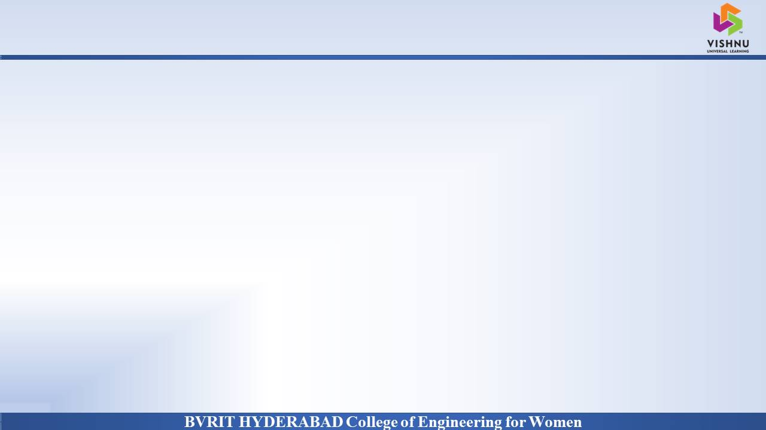
Why Should I Study this course?
PROJECT INTRODUCTION
Examples
Domain:
AI/ML
Proposed System:
COVID-19 facial mask detection is an application which restricts the growth of COVID-19 by finding people who are not wearing masks in public places which are monitored with Closed-Circuit Television(CCTV) cameras. This would be useful tool to reduce the spread of communicable disease.
BVRIT HYDERABAD College of Engineering for Women

Slide 5
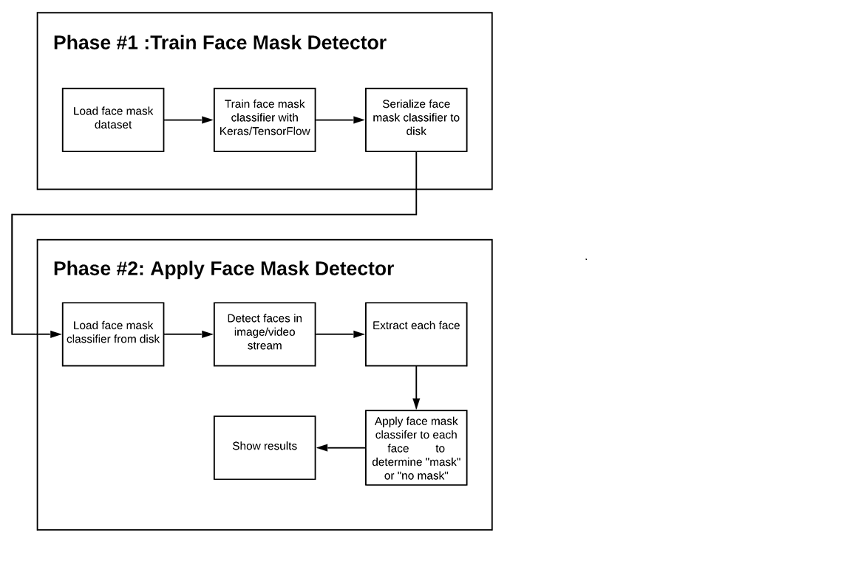
ARCHITECTURE
BVRIT HYDERABAD College of Engineering for Women
BVRIT HYDERABAD College of Engineering for Women

Slide 6
SYSTEM SPECIFICATIONS
Hardware:
Processor - Intel Core i5
Memory(RAM) - 8 GB
Storage – I TB
Software:
Os - windows 10
Google colab
Anaconda Prompt
BVRIT HYDERABAD College of Engineering for Women

Slide 7
TECHNOLOGY STACK
Python Language
Required Packages:
numpy
sklearn
imutils
keras
openCV
Tensorflow
BVRIT HYDERABAD College of Engineering for Women

Slide 8
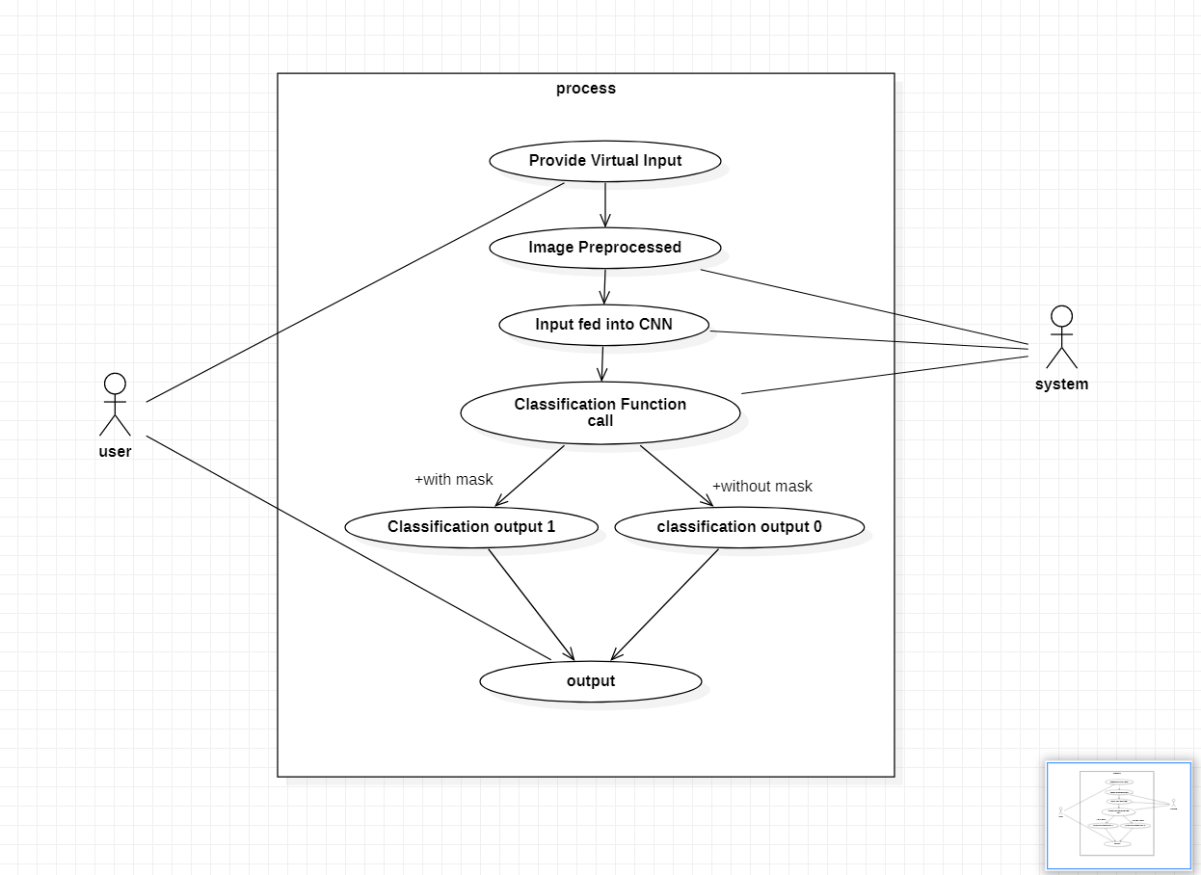
USE CASE DIAGRAM
BVRIT HYDERABAD College of Engineering for Women

Slide 9
Timeline
Review 0 | Requirements and specifications
Review 1 | Data collection Use Case Diagram
Review 2 | Building a CNN model Training the model Finding the train and test accuracies
Review 3 | Interpretation of results Report of the Project
BVRIT HYDERABAD College of Engineering for Women

Slide 10
References
Base paper:
https://ieeexplore.ieee.org/stamp/stamp.jsp?arnumber=9216386
https://www.nationalgeographic.com/science/article/face-mask-recognition-has-arrived-for-coronavirus-better-or-worse-cvd
https://www.irjet.net/archives/V7/i8/IRJET-V7I8530.pdf
Reference papers:
BVRIT HYDERABAD College of Engineering for Women

Slide 11
THANK YOU
BVRIT HYDERABAD College of Engineering for Women

